Slide 1
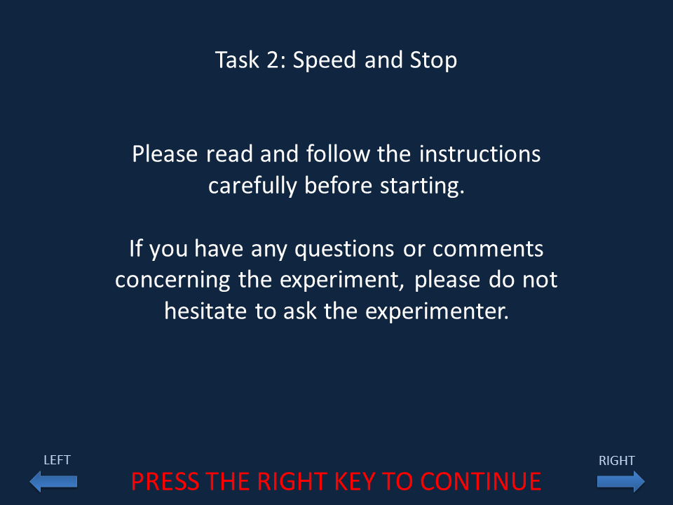

Slide 2
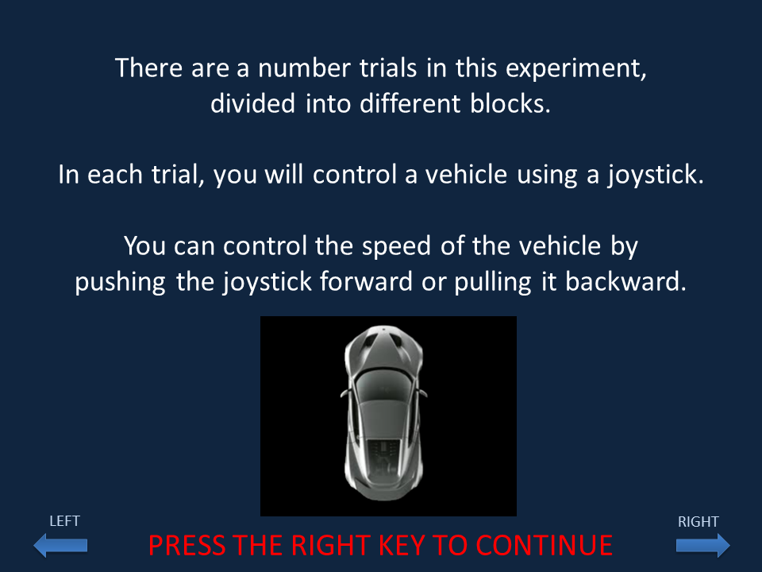

Slide 3
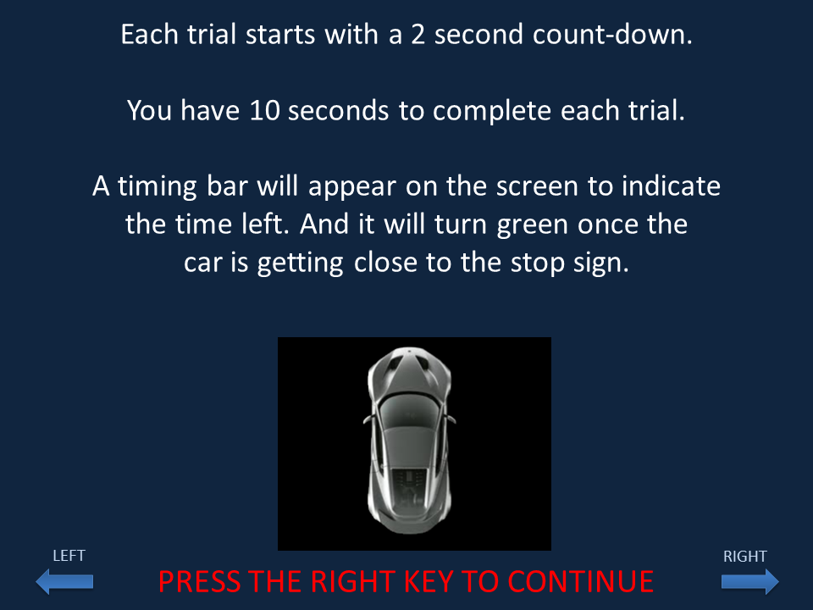

Slide 4
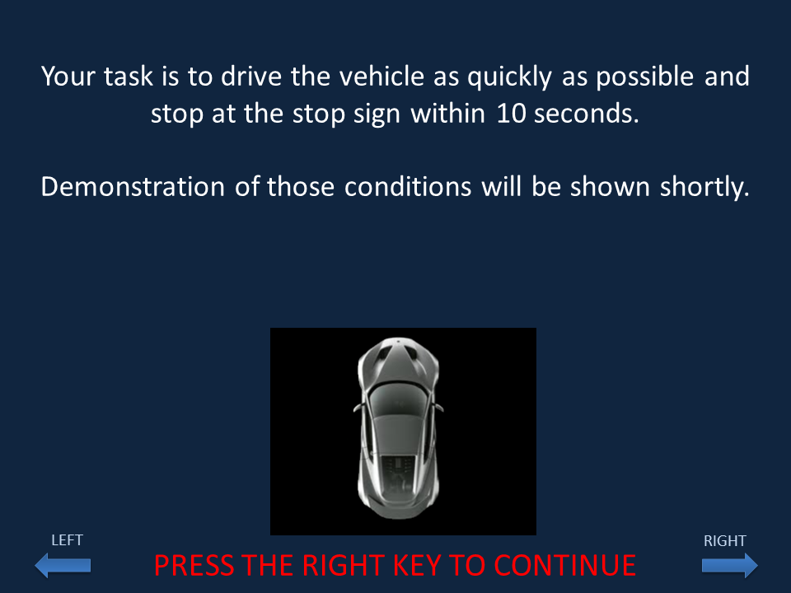

Slide 5
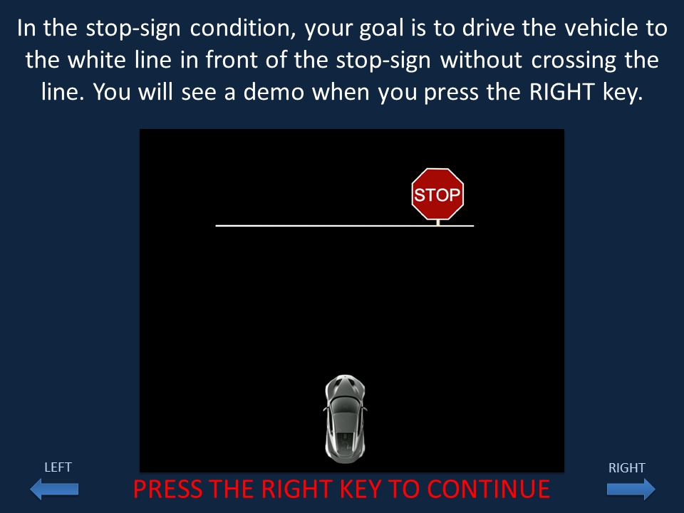

Slide 6
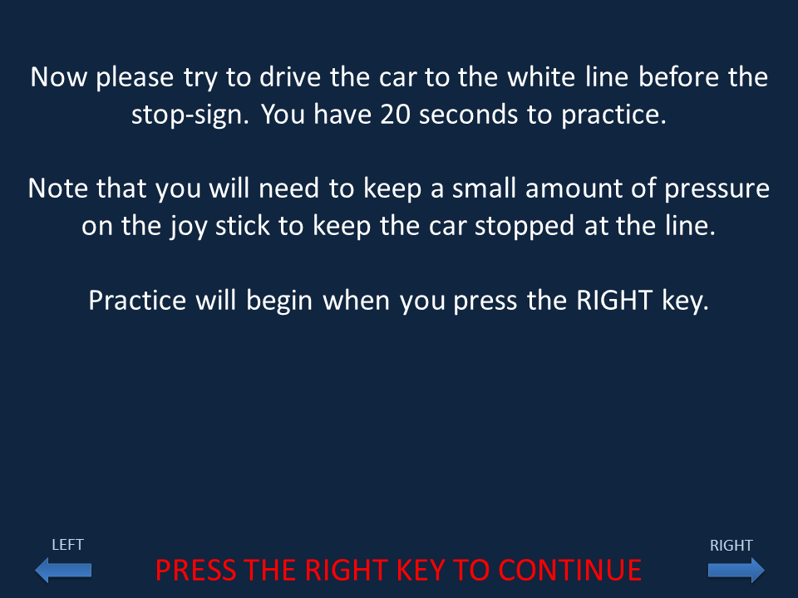

Slide 7
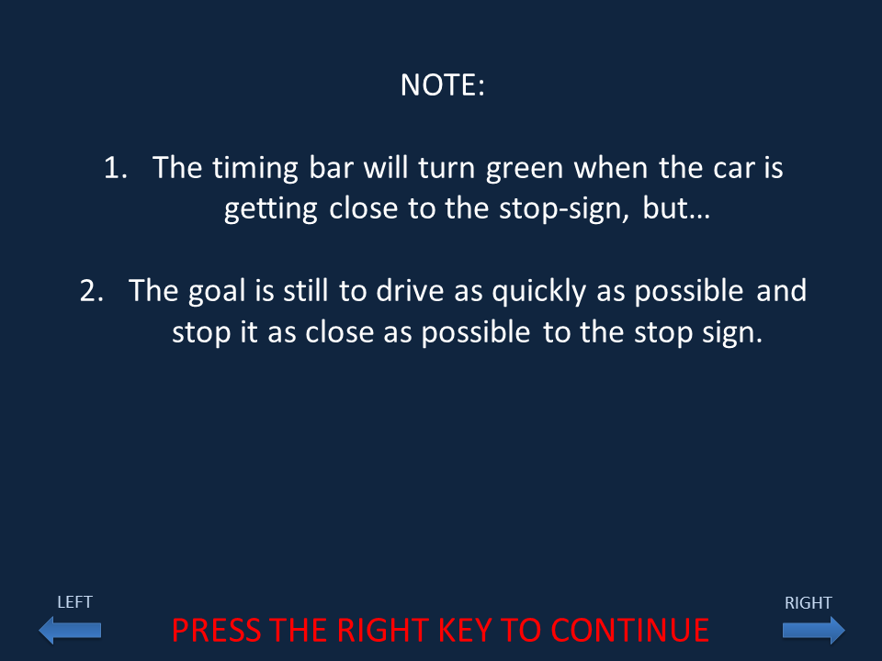

Slide 8
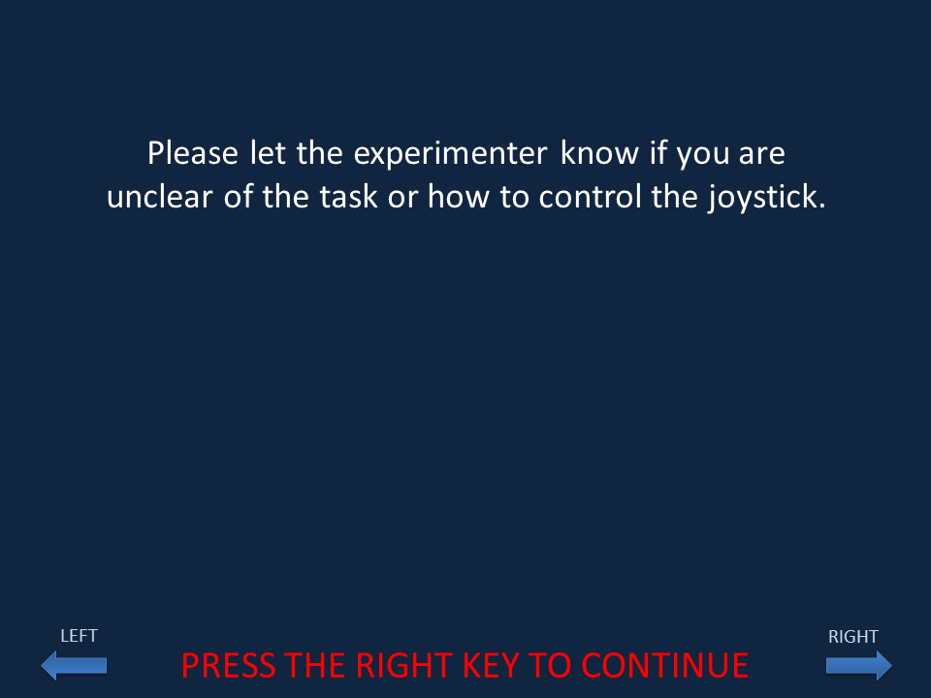

Slide 9
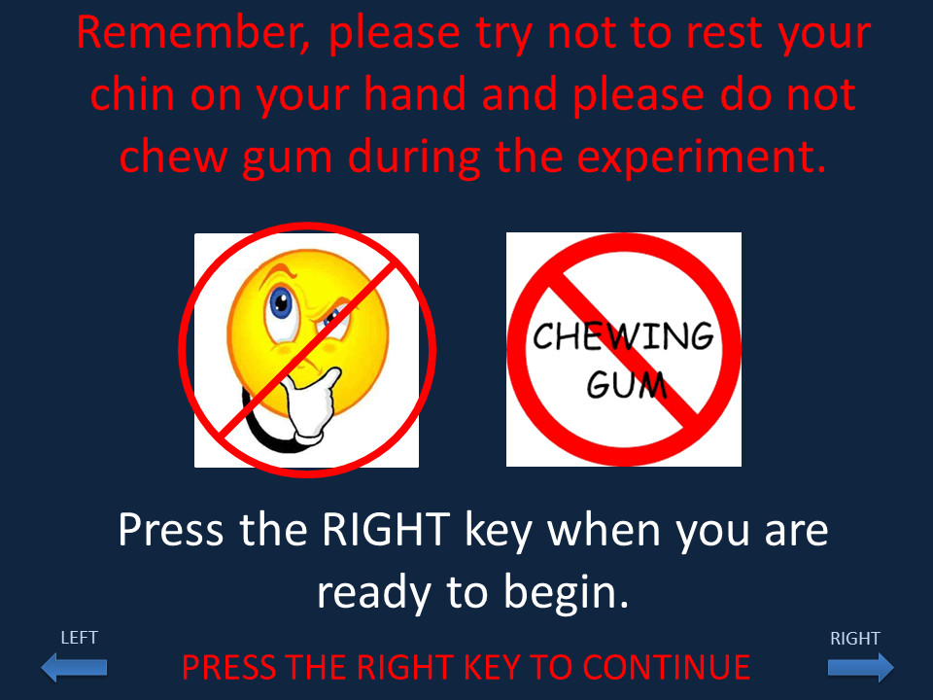

Slide 10
Driving Task
Run 1
PRESS THE TRIGGER TO CONTINUE

Slide 11
PRESS THE TRIGGER TO CONTINUE

Slide 12
PRESS THE TRIGGER TO CONTINUE

Slide 13
PRESS THE TRIGGER TO CONTINUE

Slide 14
PRESS THE TRIGGER TO CONTINUE

Slide 15
In the stop-sign condition, your goal is to drive the vehicle to the white line in front of the stop-sign without crossing the line. You will see a demo when you press the TRIGGER.
PRESS THE TRIGGER TO CONTINUE

Slide 16
Now please try to drive the car to the white line before the stop-sign. You have 20 seconds to practice.
Note that you will need to keep a small amount of pressure on the joy stick to keep the car stopped at the line.
Practice will begin when you press the TRIGGER.
PRESS THE TRIGGER TO CONTINUE

Slide 17
PRESS THE TRIGGER TO CONTINUE

Slide 18
PRESS THE TRIGGER TO CONTINUE

Slide 19
Press the TRIGGER when you are ready to begin

Slide 20
Driving Task
Run 2
PRESS THE TRIGGER TO CONTINUE

Slide 21
Press the TRIGGER when you are ready to begin

Slide 22
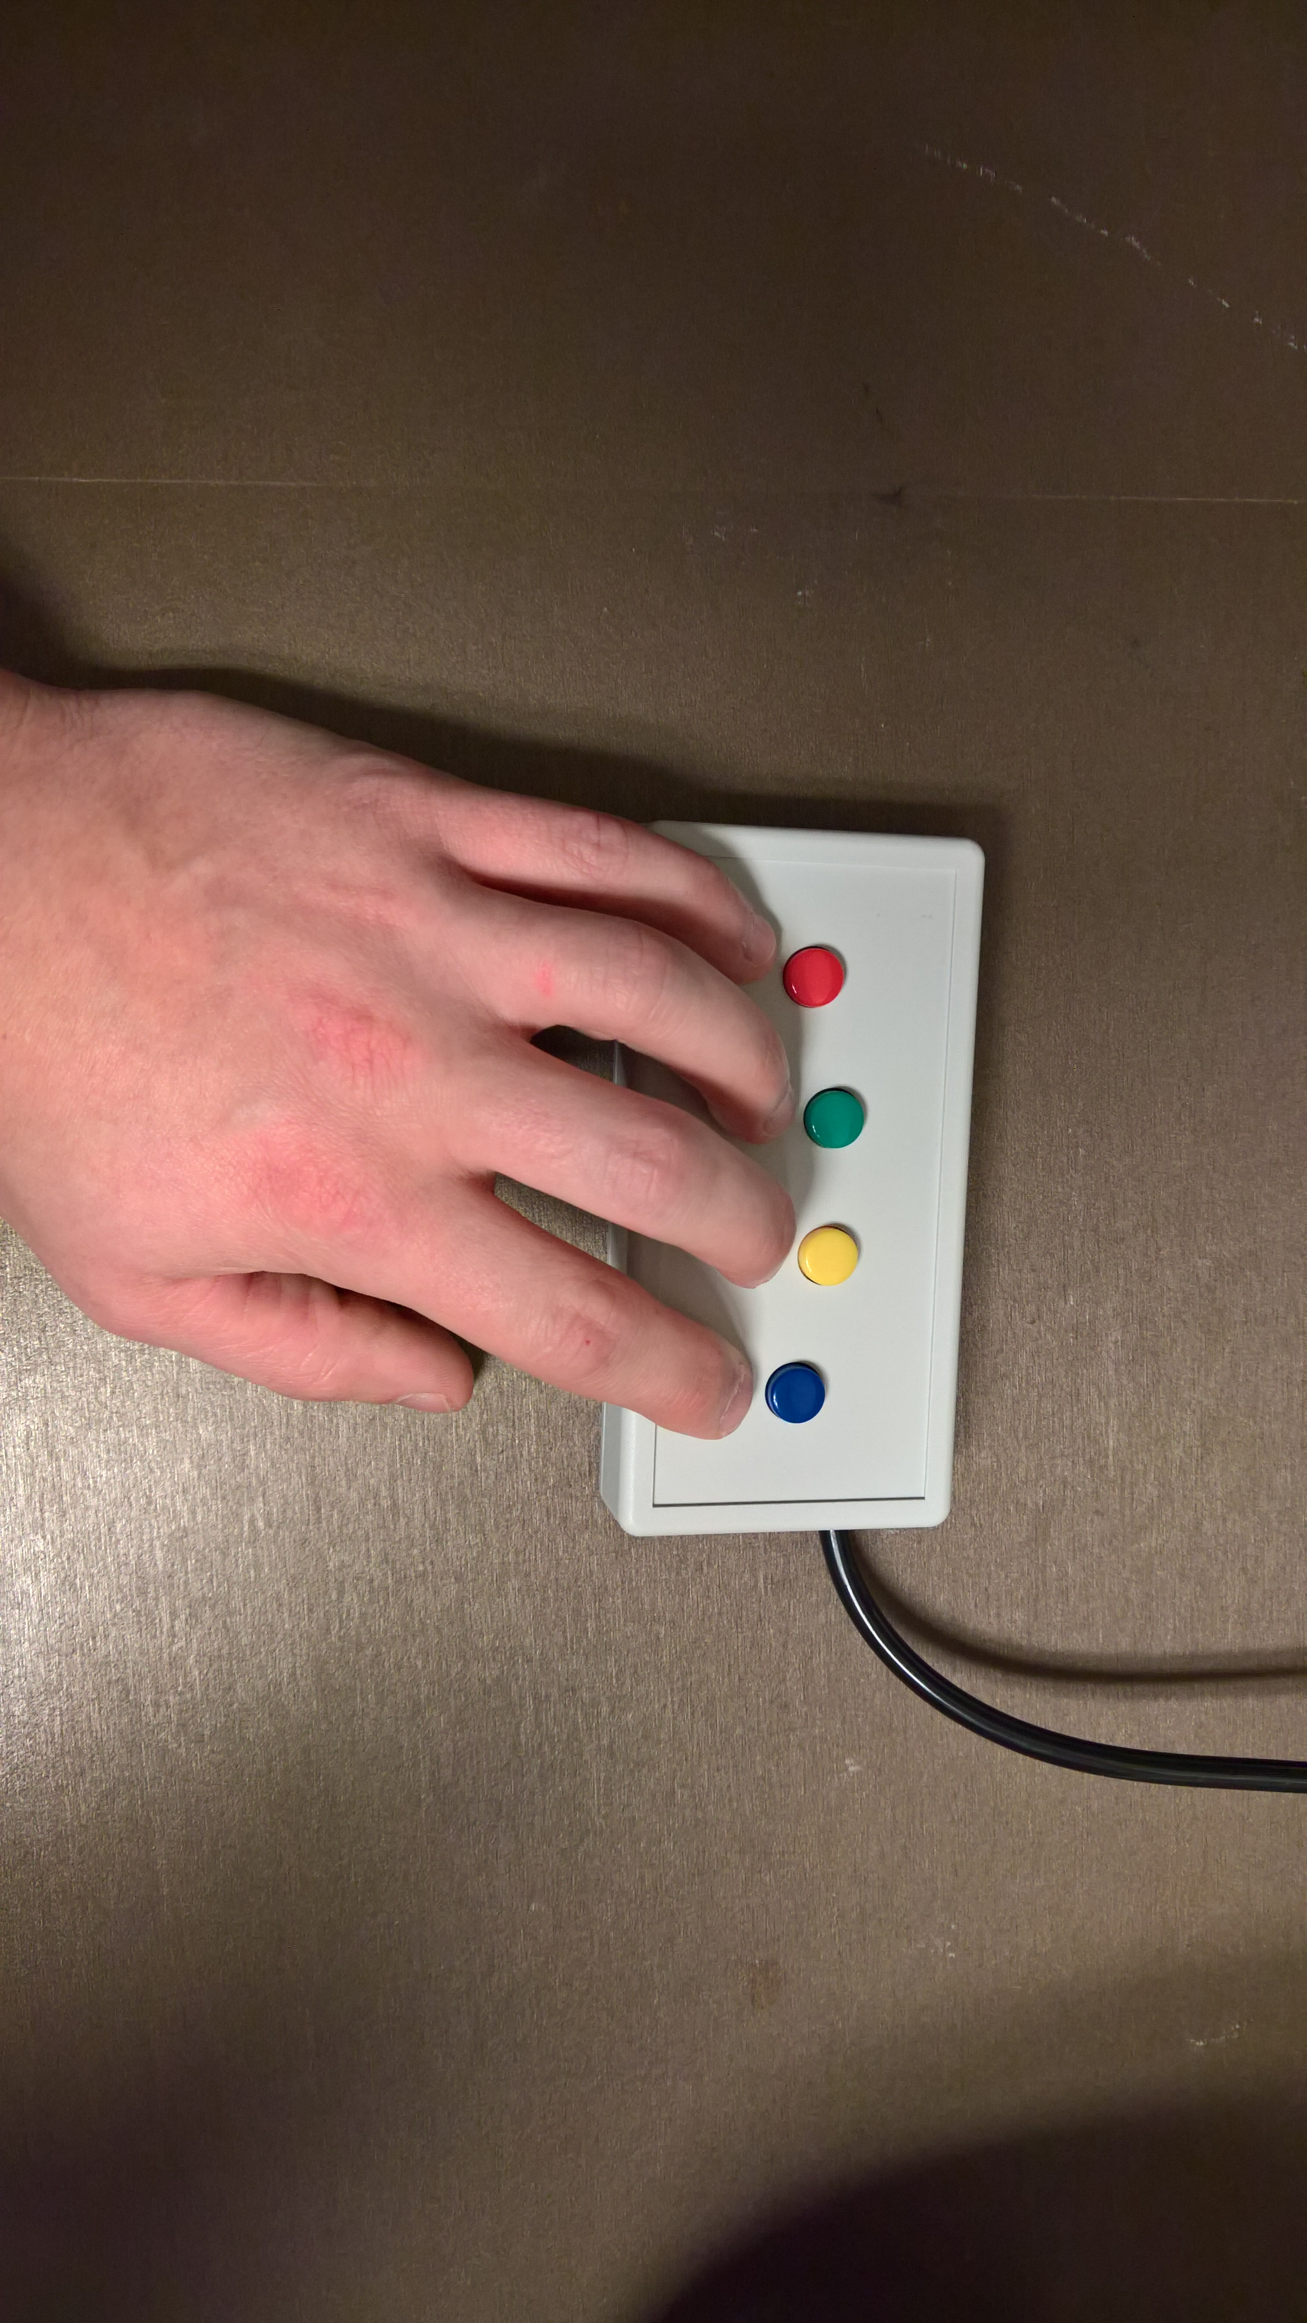
Position your hands so that your
middle finger corresponds to the LEFT Button
and your
index finger corresponds to the RIGHT Button
LEFT
RIGHT
RIGHT
PRESS THE RIGHT BUTTON TO CONTINUE

